Slide 1
Queensland Contingent

Slide 2
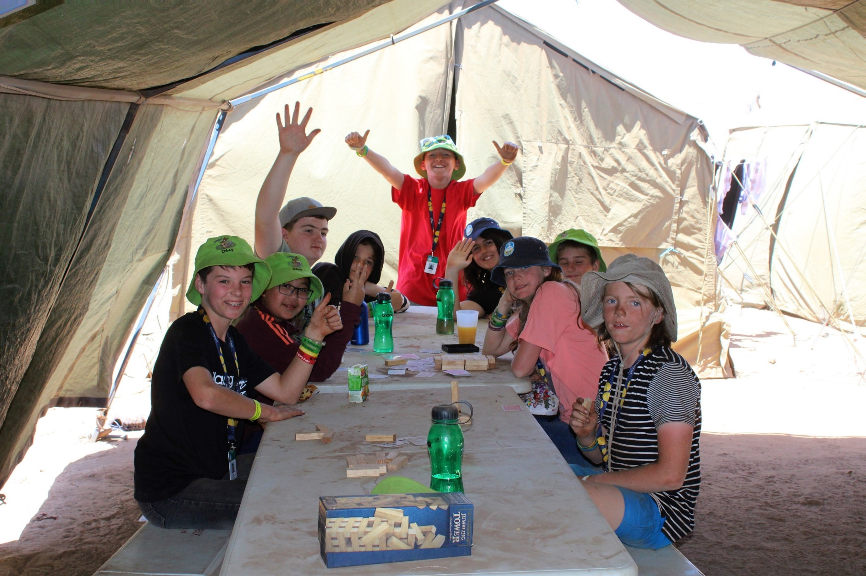
Be Prepared for fun, adventure, achievement, and outdoor action that awaits you at Maryborough in January 2025
Notes:
WELCOME
I am …
Thanks for coming
Tonight is a crash course in Jamborees
The who, what, where, why, when, and how the how much?
Plus a chance for your to ask questions.
And ... some next steps - for Cubs, Scouts, Venturers, the whole Group.

Slide 3
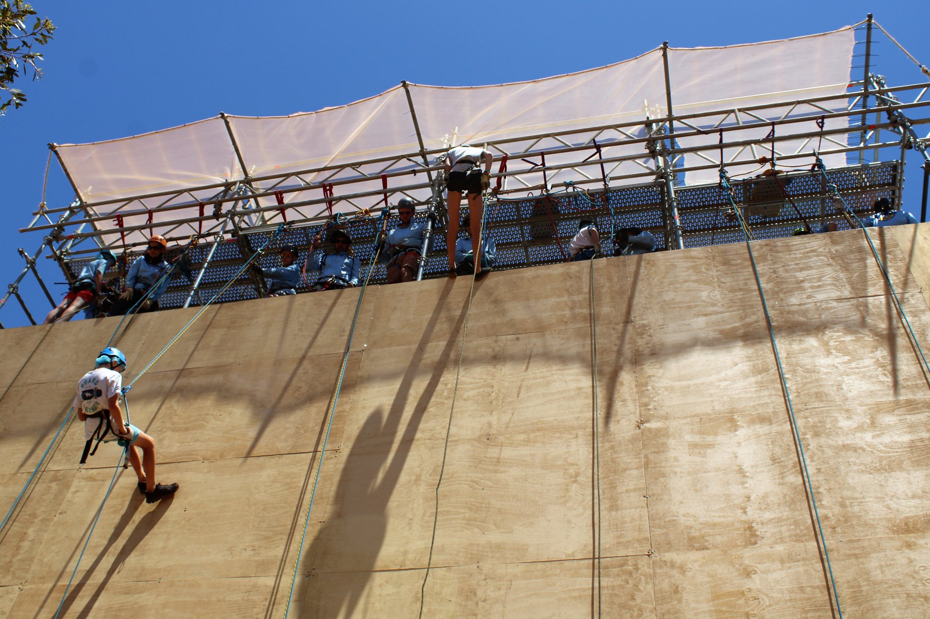
What is a Jamboree?
Notes:
WHAT
A Jamboree is a massive national camp for Scouts aged 11-14 and this time around for Venturers aged 15 and 16 years.
Older Venturers, Rovers, Leaders, Adult Helpers can also come and help with the running of the Jamboree
Most Scouts get only one chance in their life to enjoy a Jamboree as Scout and because AJ2022 was cancelled some missed out so that is why some Venturers (15 and 16 years olds) can attend as participants or support workers.
A Jamboree is 10 days of action, expeditions, entertainment and daily life, camping with 12,000 others.

Slide 4
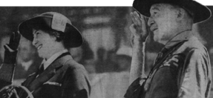
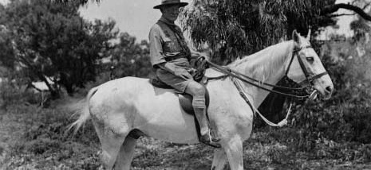
Jamboree Basics
Australian Jamborees are held every three years (since 1934/5 in Frankston, Victoria).
The AJ sites move around the country, this time we (Scouts Queensland) are hosting the Jamboree.
The last time an Australian Jamboree was held was in SA in 2019.
AJ2022 was cancelled due to uncertainty of COVID
After AJ2025 the Jamboree cycle will be every four years, so the next Jamboree won’t be until 2029.
Notes:
Australian Jamboree began in 1934 and are held every three years.
World Jamborees are held every four years.
It’s literally a life-changing experience that you will never forget.
The AJ sites move around the country, this time we (Scouts Queensland) are hosting the Jamboree.
The last time an Australian Jamboree was held was in SA in 2019.
AJ2022 was cancelled due to uncertainty of COVID
After AJ2025 the Jamboree cycle will be every four years, so the next Jamboree won’t be until 2029.

Slide 5
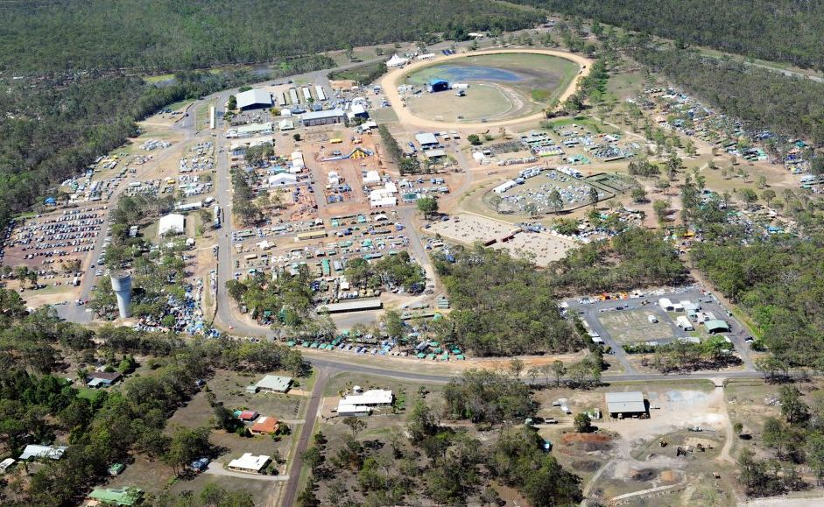
This is the best of Scouting, all in one place!
Notes:
The Jamboree site is a small city, housing & feeding over 12, 000 people.
It includes stages, shops, entertainment, food, activities, campsites, meeting places, and more food.
It’s like taking a small town and filling it with Scouts – imagine the friends you’ll make!

Slide 6
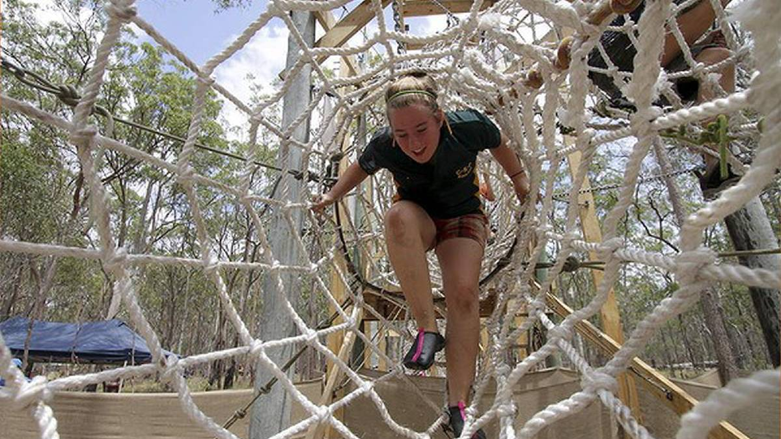
Why do we have Jamborees?
Notes:
WHY
The aim of Scouting is to encourage the physical, intellectual, social, emotional and spiritual development of young people.
A Jamboree is a crash course in the Scout program, an intense 11 days with friends old and new.
Scouting is linked to increasing resilience in young people, and come with benefits like more positive mental health, that can last a lifetime.
At AJ2025, you will care for yourself and help others, do your share of cooking and other chores with your Jamboree Patrol, while enjoying an amazing range of new experiences – from rock concerts to adventurous expeditions.
So much fun, friends, new experiences.
A Jamboree is just two weeks away from home, but Scouts come home two years older!

Slide 7
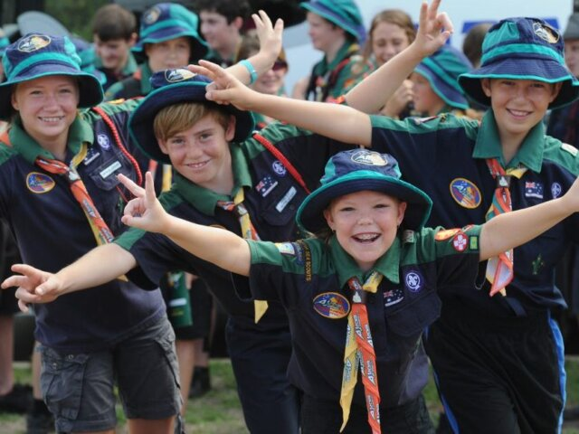
Who can go?
Notes:
WHO
A Jamboree is generally for Scouts – aged 11 to 14 but for AJ2025 Venturers aged 15 and 16 years can come along as participants or as supporters running the Jamboree
There are badgework requirements and you need at least 10 nights camping as a Scout or Venturer
Leaders also have a fantastic time at Jamborees, either working as Scout Leaders in the Jamboree Unit, sharing the Jamboree with the Scouts.
Or as Service Leaders or Activity Leaders.
Older Venturers and Rovers too!
It’s an incredible and very affordable experience because a Jamboree needs many people to make it happen.

Slide 8
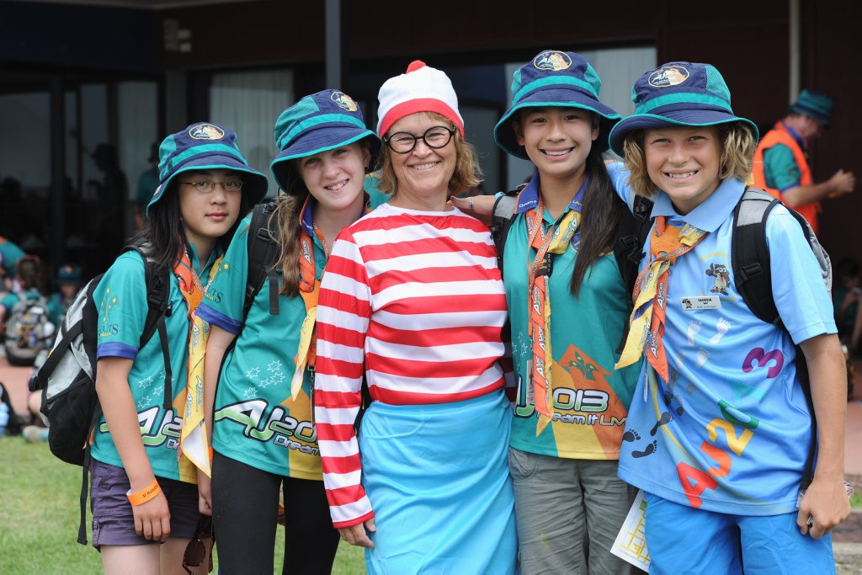
Opening Ceremony 6th Jan 2025
Closing Ceremony 15th Jan 2025
10 Days
Queensland Contingent
Move In 5th Jan 2025
Move Out 16th Jan 2025
12 Days
When is AJ2025?
Notes:
WHEN
The Jamboree runs from Monday January 6 2025 to Wednesday January 15.
That’s 10 days on site plus a day travelling to and from the Jamboree.
Queensland Scouts move in on January 5, and head home on January 16.
So, for most, it’s a 12-day experience.
Families will be able to visit the Jamboree during the middle weekend of AJ – 11,12 & 13 Jan with Future Scout Day on 12th Jan.

Slide 9
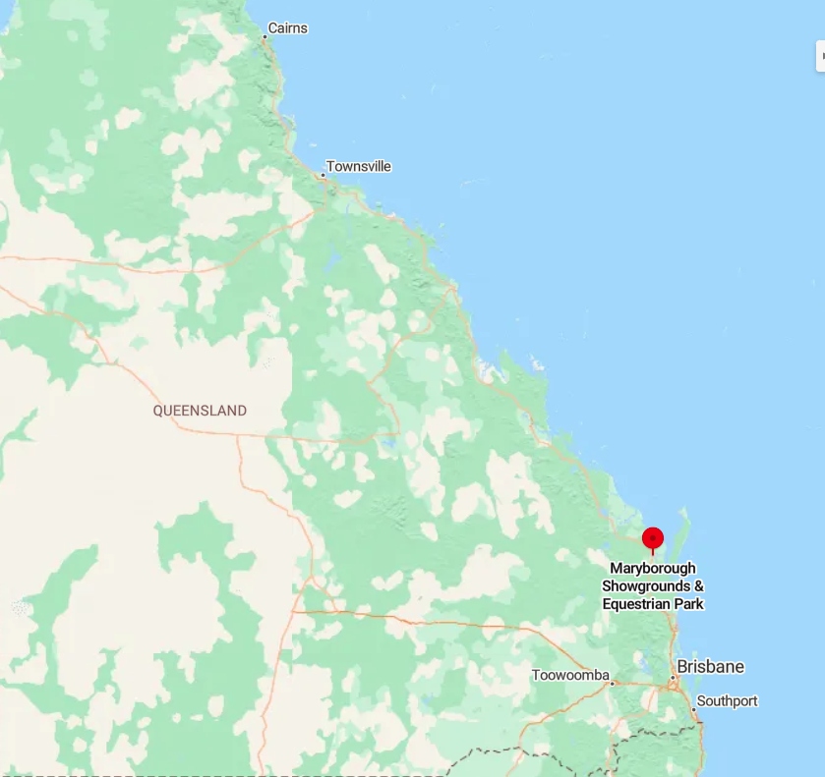
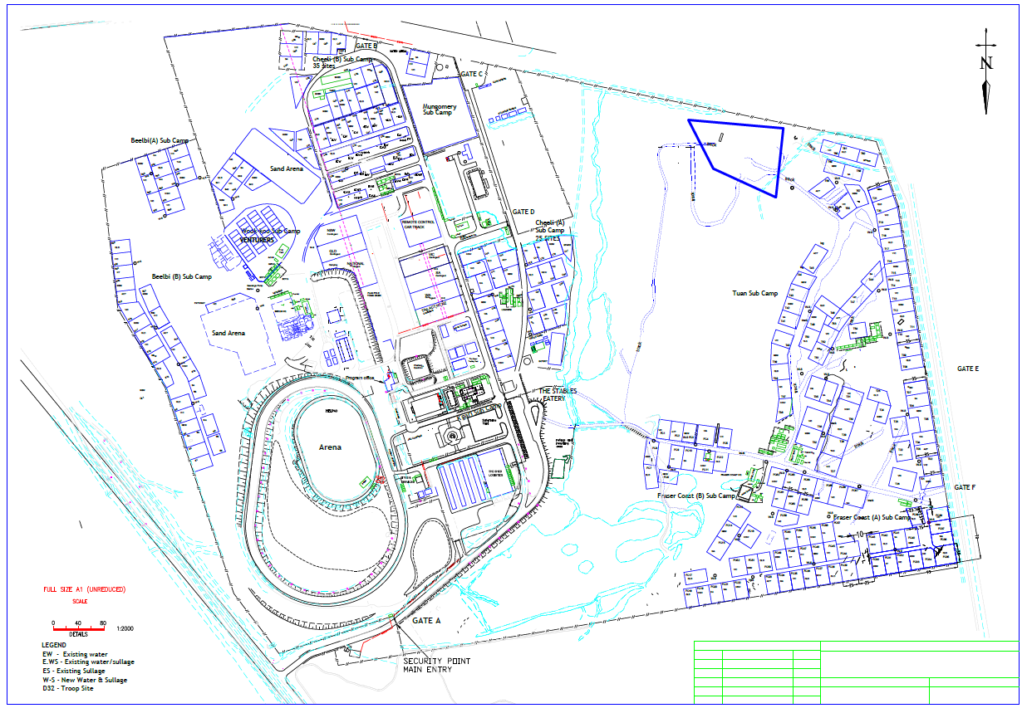
Maryborough Showgrounds & Equestrian Park
Where is AJ2025?
Notes:
WHERE
AJ2025 is at the Maryborough Showgrounds and Equestrian Park.
Maryborough is about 3 hours north of Brisbane along the Bruce Highway.
Scouts will be travelling to and from the Jamboree by bus with some of our Scouts living further away (Cairns, Townsville, Mt Isa and Longreach) will be flown into Brisbane and then bussed up to the Jamboree site
We held AJ2013 here, so we know the site well.

Slide 10
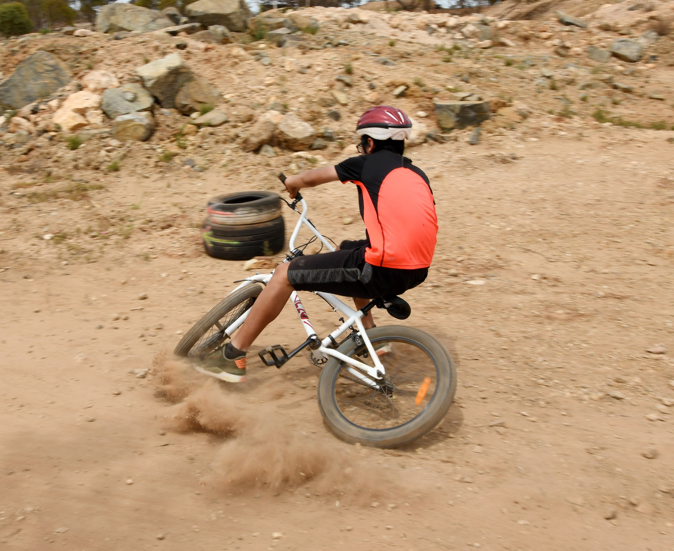
How much?
Notes:
HOW MUCH
The cost for Scouts and eligible Venturer Scouts attending as participants the cost is $2400.00 and this includes everything including getting you to the Jamboree and back again, all your food and accommodation and of course all the amazing activities you will be participating during your two weeks at the Jamboree. The only other money you will need is your own spending money for a drink, ice cream of buying a souvenir to take home.
For all others (Venturers, Rovers, Leaders and other eligible adults) who will be supporting the Jamboree the fee is $1680.00.
A $50.00 deposit will be required with the initial application with the first instalment of $800.00 not due until 31st March 2024.
Payment details are available on the Contingent Website and correspondence that will be sent to each applicant.

Slide 11
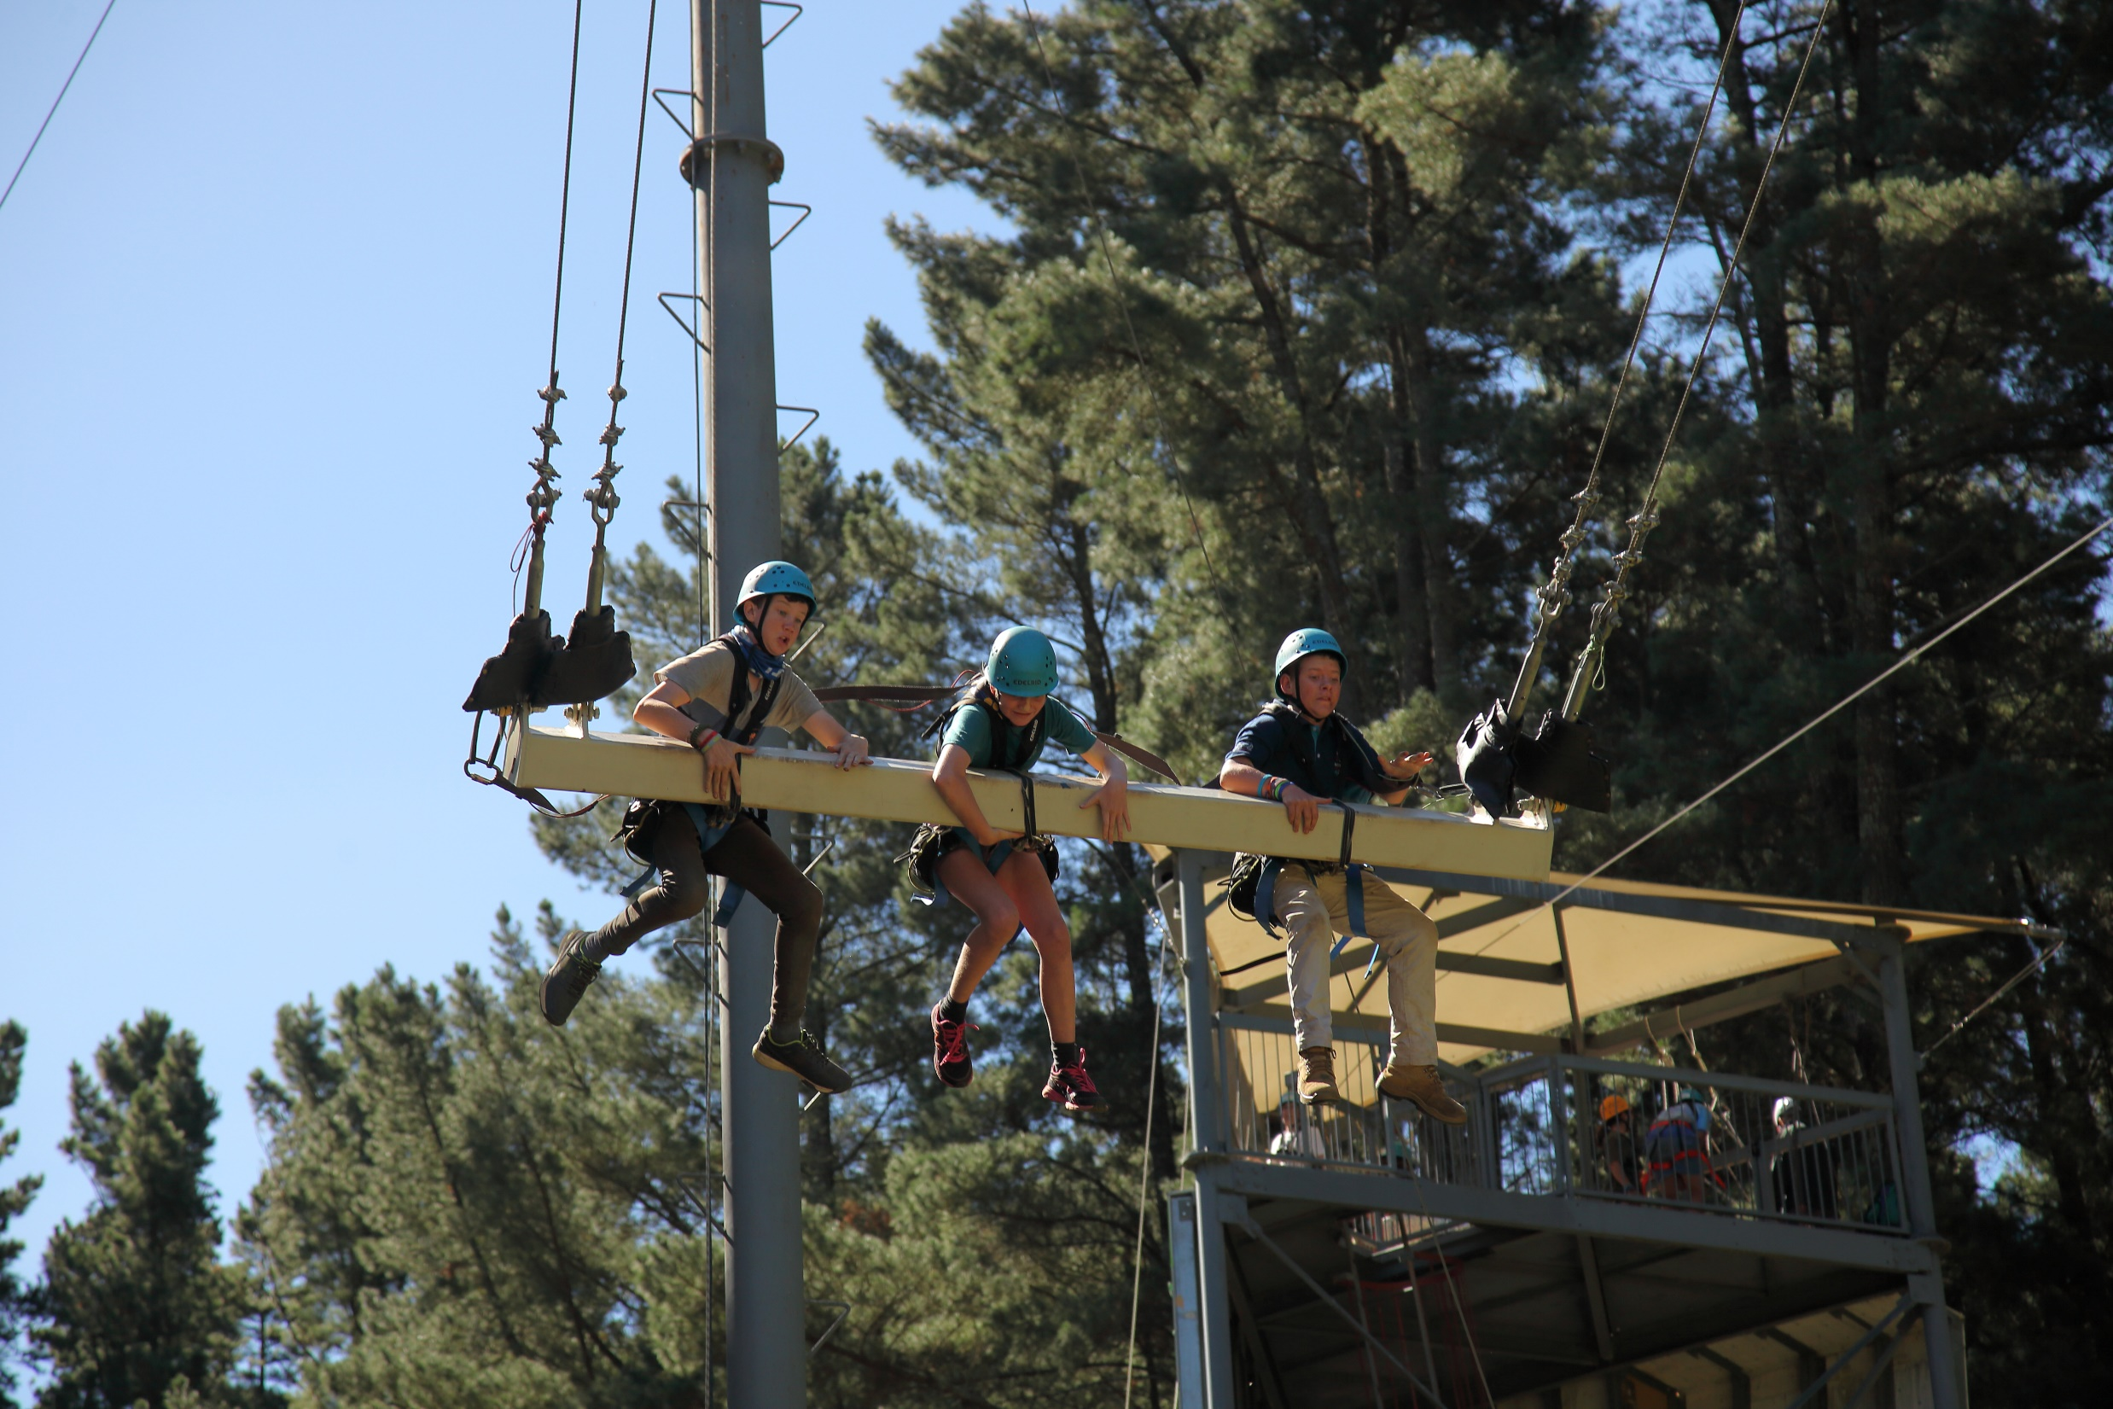
Fundraising
Notes:
FUNDRAISING
So now you know the cost of the Jamboree it is time to think about raising funds to get as many of those eligible to attend being there in Maryborough January 2025.
To ease the burden on families, there are usually two types of fundraising.
Scouts save and do jobs around the home to earn money to put toward the Jamboree.
Bottle and can recycling is a great way to raise funds
2. And Scout Groups work together to run a few big fundraising events and share the profits with families.
For those with special situations, there may be funding assistance too though the Lord Baden-Powell Society that raise funds for major events such as Australian Jamborees.
Think about it, the cost of a large flat white coffee a day ($6.25) saved will get you to AJ2025!
There is a lot to do so now is the time to get cracking.

Slide 12
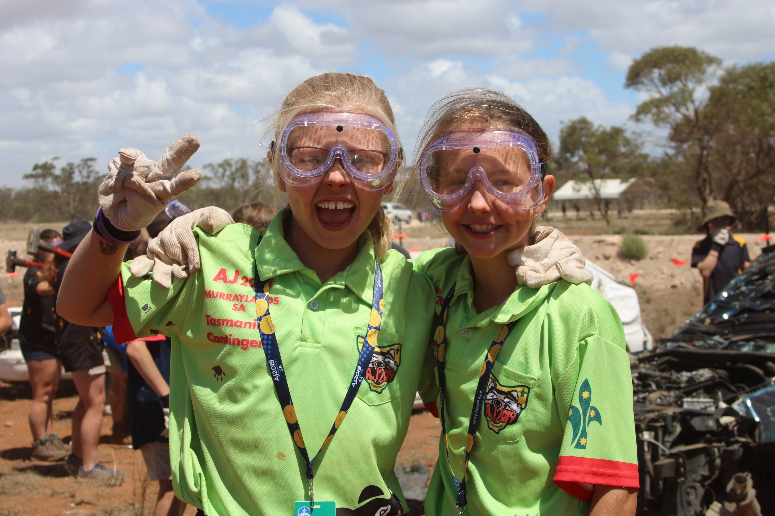
Q&A
Notes:
QUESTIONS & ANSWERS
And now it’s time to ask any questions you may have.
Refer to Q&A sheet

Slide 13
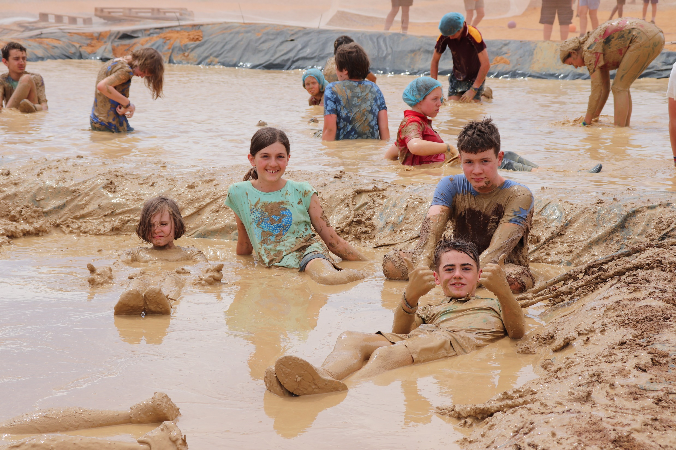
Action!
Notes:
ACTION
Now it’s time for action.
Applications are due to open on 1st November 2023
If you have already sent in your expression of interest and you will be notified when applications open, you will be the first in the que!
To express your interest (up to 31st October 2023) or to apply to attend AJ2025 (from 1st November) visit the Jamboree website at 26th Australian Jamboree – 6 – 15 January 2025, Maryborough Queensland (aj2025.com.au) or the Queensland Contingent website at AJ2025 QLD Continent | (scoutsqld.com.au)
It is now over to you to be part of AJ2025.

