Slide 1
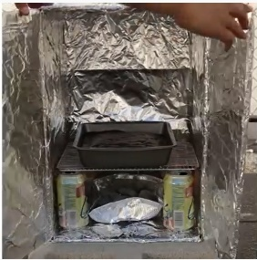
Scouting @ Home Program
12 August 2021
Overview
This week our activities focus on things you can do individually, with your family or with your patrol or even your patrol of mates who may or may not be Scouts. Some of these activities may give you some ideas to explore further for your Special Interest Awards or Milestone activities. Remember, before you start each activity to Plan>Do>Review> and check out the challenge areas covered.
Make & Video a Song- Caring for Others
Improving Your Stamina and Friendship
It’s really special to share with others at this time. Pick a tune you like and write some simple words that show you are thinking of others. Video this on a mobile phone and send to a friend. Maybe even a patrol song could be made
1
2
Are you still using that running track that you have created around your house. Get enthused at running the track. Do it with a friend. Beat you own time. Follow a great Qld Scout, Cedric Dubler who showed how to help friends at the
Olympic games last week.
Clean Up Dirty Water - Capricorn Scouts
Knotting Catch up
Join scouts from Mt Archer, Capricorn Region and learn how to make your dirty water clean. Know how to do it- then teach someone else. https://www.youtube.com/watch?v=vXP9HNXUCVg&t=8s
Thanks guys –
Make a list of those knots you still have to master. Knots can be learned and practised virtually! Which ones can you practise together?
Who is the fastest tying a Prusic?
https://www.youtube.com/watch?v=EFHxQ5fiUvI
3
Cooking in Box Oven
Patrol Scavenger Hunt in-house
Try making a box oven and cooking something small in it. With some practice, you could even cook a whole meal in it!
https://www.youtube.com/watch?v=HFwXPkI5OtU
Plan a scavenger hunt and share with your patrol. This could be a Lead activity. Make a list of things you can find around the house. They have 5 mins to collect the most. Now share your items and tell stories about these.
6
1 of 2

Slide 2
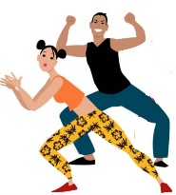
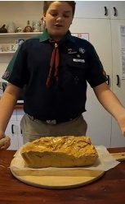
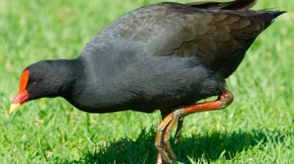
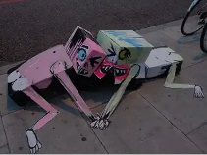
Scouting @ Home Program
12 August 2021
Zumba Scouts
Josh and Honeycomb
Get your own music and make your own makeshift Zumba! You need to share it with each member and get them to repeat the previous dance move and add a new one to the mix.
Join with Josh and the Scouts from Tyakunda District and make your own honeycomb. Instruction sheet and video provided. Thanks guys.
https://www.youtube.com/watch?v=IGgwHPNRmgM
7
Patrol Quiz
Bird Watch
9
10
Working as a patrol, each member creates three questions about their Unit and its work. Share these and ask another patrol to do the same. Then join together and try to answer each other’s questions. See who knows the most about your Unit.
Think about the different types of birds that are in your area. Can you identify five different types. Take a picture, draw them and learn about their habits. Share this with your patrol.
Art from Waste
Desk Zen Garden
Ever tried recycling different waste. Look at something old that is about to be thrown out. What can you do to make this useful. Crazy ideas accepted. Share your creations. We can even make trash into art!
It’s also important to look out for your mental health during this time of social distancing. Why not build a desk Zen garden your workspace? A desktop Zen garden can be a calming addition to any work space, whether it’s your home office, or your make-shift school for the time being.
11
12
Watch Our Scout Program
Review >
Grab your popcorn and watch this week’s video about one of the benefits of being a Scout.:https://www.youtube.com/watch?v=mvq4hp4SdB
Resilience and readiness. Are you on board now for the Youth Program?
Now it’s time to think about what you did this week. What went well? What did you enjoy? How could you do it better? What can you share with others in your patrol. Send us your pictures or ideas we can use for other activities to:
scoutingathome@scoutsqld.com.au
13
14
2 of 2

