Slide 1
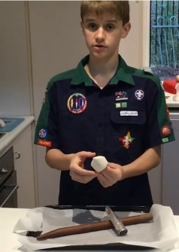
Scouting @ Home Program
19 August 2021
Overview
This week our activities focus on adventures- based on things you can do individually, with your family or with your patrol or even your patrol of mates who may or may not be Scouts. Some of these activities may give you some ideas to explore further for your Special Interest Awards or Milestone activities. Remember, before you start each activity to Plan>Do>Review> and check out the challenge areas covered.
Take a Virtual expedition
Improving Your Stamina and Friendship
Interested in knowing more about NASA? Check out this great site and learn three new things you can share about the importance of NASA.
https://artsandculture.google.com/partner/nasa
1
2
Week 3 so we should start to see some improvements in your use of that running track you have created around your house. Get enthused, warm up and get into the habit. Do it with a friend. Beat you own time.
Know Our Coins
Hitch up there
Can you correctly identify the animals on our 5 cent, 10 cent, 20 cent, one dollar and two dollar coins. Make a rubbing of each coin and check out the artwork involved. Do you know which ones are monotremes? Make up a simple 5 answer quiz about our coins.
Can you correctly tie a bowline and sheetbend when you are blindfolded? Now what about behind your back. A truckies hitch is always useful. Check it out at https://www.youtube.com/watch?v=fvjoE-xAfts
3
Zac and his patrol woggle
Patrol Scavenger Hunt in-house
Watch Zac in this video as he makes a Patrol woggle. Can you make one that would be suitable for all members in your Patrol?
https://www.youtube.com/watch?v=YG3xqFjMVqo
Plan a scavenger hunt using your backyard. Make a list of 10 things that would be in everyone’s backyard and share with your patrol. This could be a Lead activity. They have 3 mins to collect the most. Now share your items and tell stories about these.
6
1 of 2

Slide 2
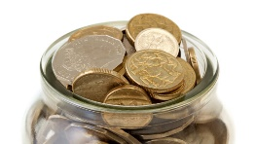
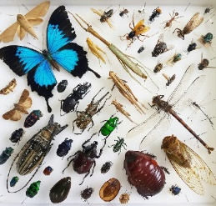
Scouting @ Home Program
19 August 2021
Design a Coin
Unit Code
Get your pencils and design a scout coin that could be used at Cuboree. It could be worth a Dollar. Why did you choose the deign. This could be a great lead activity for your patrol.
7
It’s really important at this time that we think about the safety of ourselves and others. Get a copy of your Unit Code and with a friend, consider this, discuss any changes that could be made to improve your Unit. Share these ideas with your patrol.
Sandwich Surprise
Your Insect Watch
9
10
Get out five different items you like to put on your sandwich. Place them in a row and memorise the order. Now with friends, blindfold each member and tell them three different things they must put on their sandwich. Now, eat and
don’t waste any food.
Think about the different types of insects that are in your area. Can you identify five different types. Take a picture, draw them and learn about their habits. Share this with your patrol.
Your Law Chart
Personal Relaxation
11
Now you have worked so hard, it’s time for a personal reward. Select a nice piece of music, a favourite spot in your local area and give yourself a nice relaxing break. Do something you enjoy doing. Think of a friend- maybe talk with them. Let them know that you care.
Let’s revisit our Scout Law. Can you remember the three key words. Put these at the top of the sheet of paper and see if you can draw at least three different ways we can do this in our activities and our lives. Pick out the one you enjoy the most.
12
Watch Our Scout Program
Review >
https://www.aj2019.com.au/resources/videos/
Grab your popcorn and watch this week’s video. Want to know more about Scout Jamborees? Watch some highlights from Adelaide in 2019. Are you wanting to go to be major scout event? Let’s hope we can all do so soon.
Now it’s time to think about what you did this week. What went well? What did you enjoy? How could you do it better? What can you share with others in your patrol. Send us your pictures or ideas we can use for other activities to:
scoutingathome@scoutsqld.com.au
13
14
2 of 2

